Slide 1
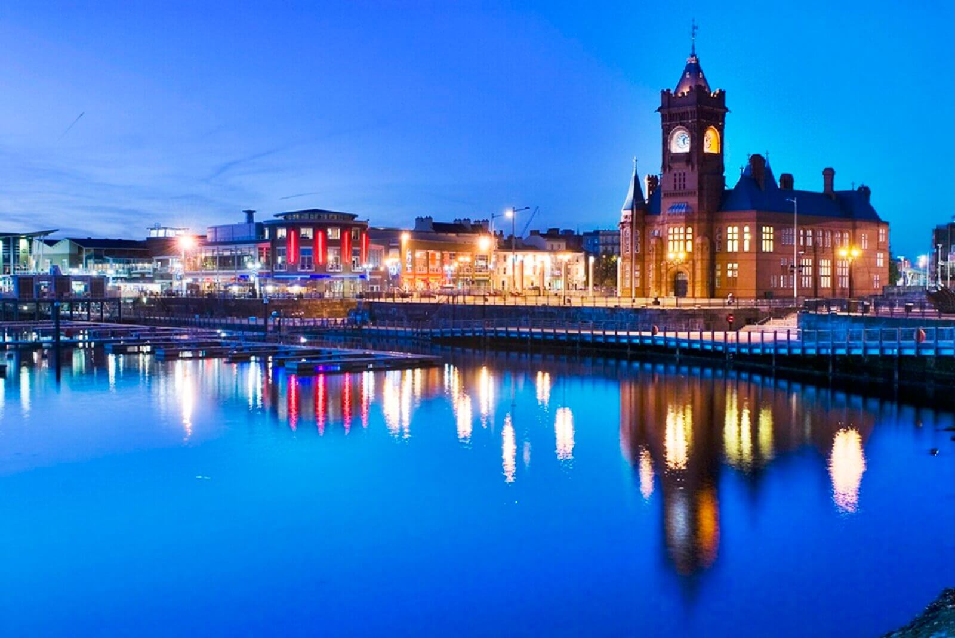

Cardiff
Presentation was made by the student of group Ks1-17
Alekseyev Aleksey Alekseevich
Supervised by the teacher of English
Tatyana Evgenyevna Dmitrieva
Cheboksary 2018

Slide 2
Plan:
Brief History and Geography
Cultural life
Transport
Sights
Conclusion

Slide 3
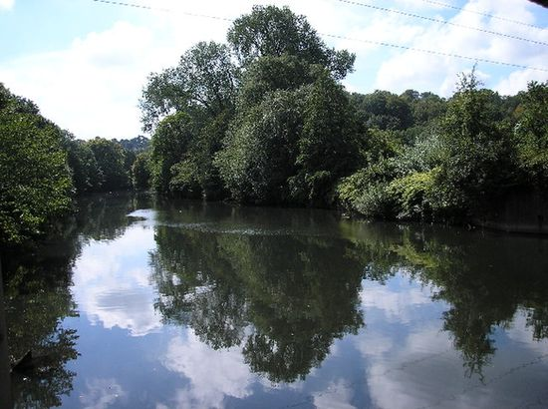
History
Cardiff is the capital of Wales since 1955 and one of its largest cities. The history of this area is connected with industry: more than a century ago coal was actively transported from Wales through this city. Cardiff received its name from two different words. The first half is translated as "fortress", but the second half is "day". But such an option is incomprehensible, so the modern interpretation of the name is different - Cardiff is translated as "a castle on the river Taf."
The Taf River

Slide 4
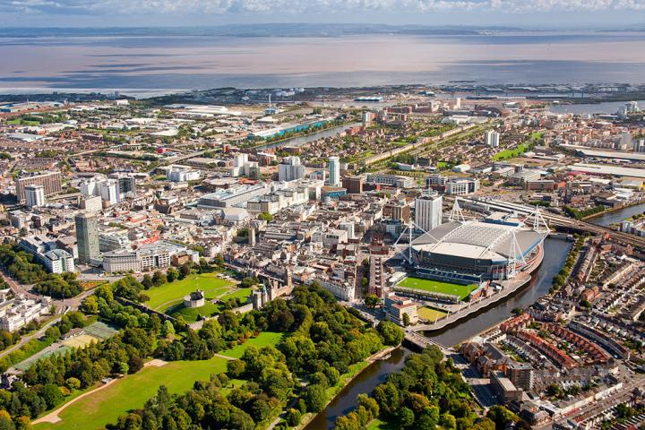
Geography
The city is not very big (about 6.5 square km), all the sights can be easily visited cycling slowly. The weather of Cardiff is quite favorable both for locals and tourists - the climate is quite dry, the norm of precipitation does not exceed the average. In July the average temperature is 16 degrees, and in January - 4-5 degrees. Therefore, Cardiff can be visited at any time of the year without fear of severe cold.

Slide 5
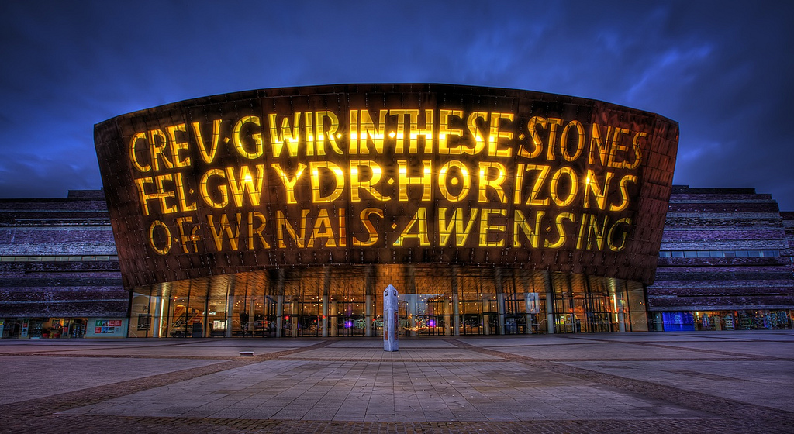
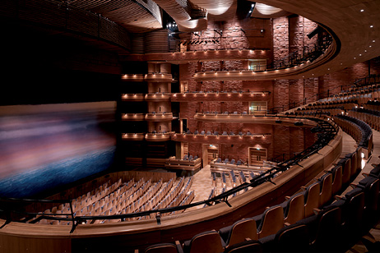
Cultural Life
Cardiff is very much appreciated for its rich cultural life. Here a lot of people speak the ancient Welsh language, mostly in the western part of the city. Local residents are very fond of various concerts of symphony orchestras and actively attend theaters and choral singing. All major television channels and radio stations in Wales are also located in this city .
Wales Millennium Centre

Slide 6
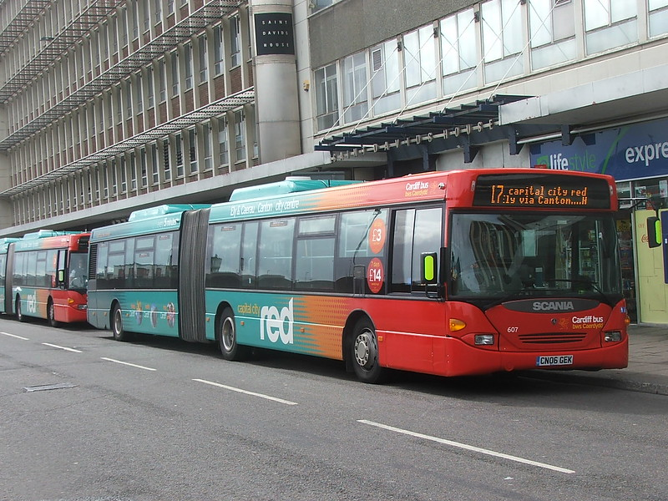
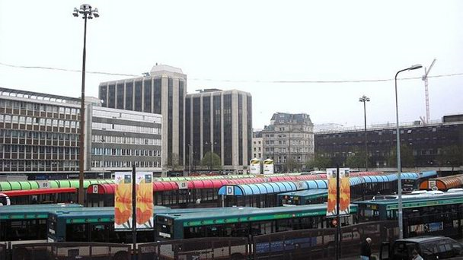
Transport
Since Cardiff is the capital of Wales, the road and transport network are very well developed here. The quality of the roads amazes tourists, all the roads here are at a proper level , from small lines to highways. But the railway station "Cardiff-Central" has become the busiest in the whole country as it helps to connect Wales with other major cities throughout the UK.
Bus in Cardiff
Railway station "Cardiff-Central"

Slide 7
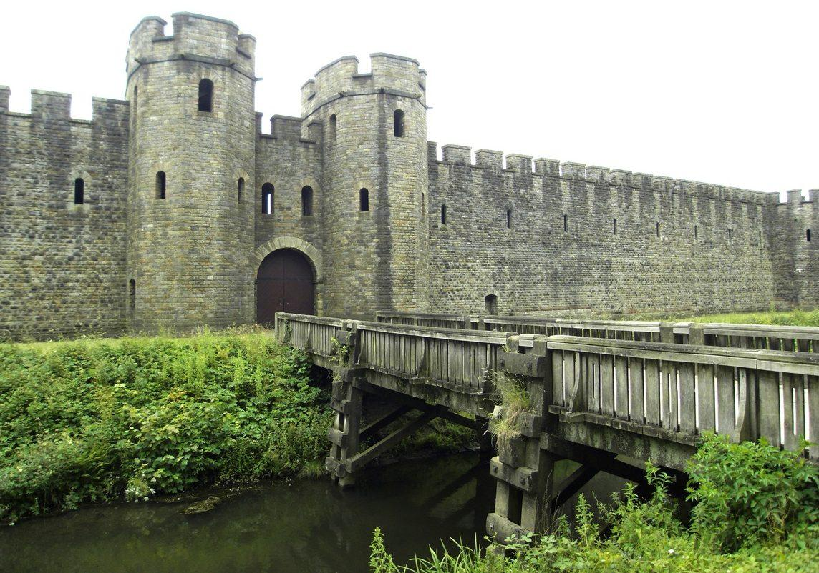
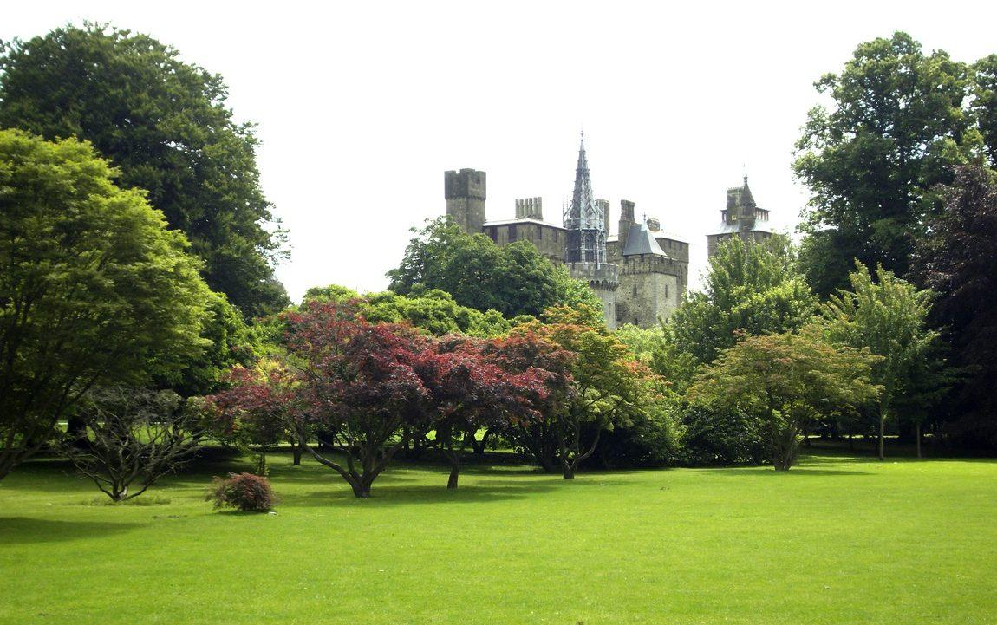
Sights
Cardiff Castle
Located within beautiful parklands at the heart of the capital Cardiff Castle’s walls and fairytale towers conceal 2,000 years of history
Bute park

Slide 8
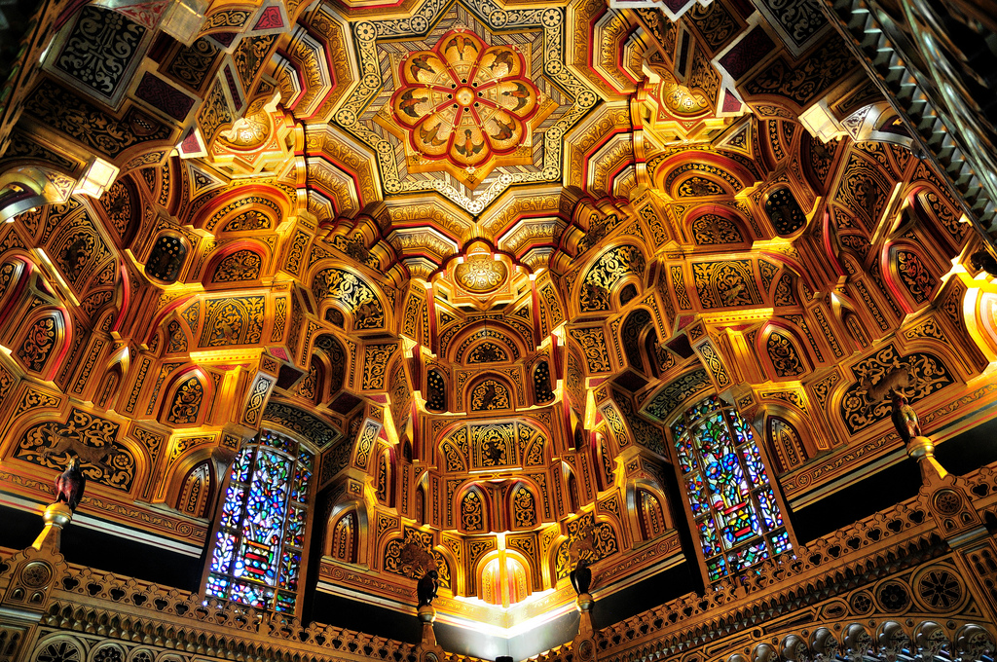
Sights
Cardiff Castle
The Arab Room at Cardiff Castle

Slide 9
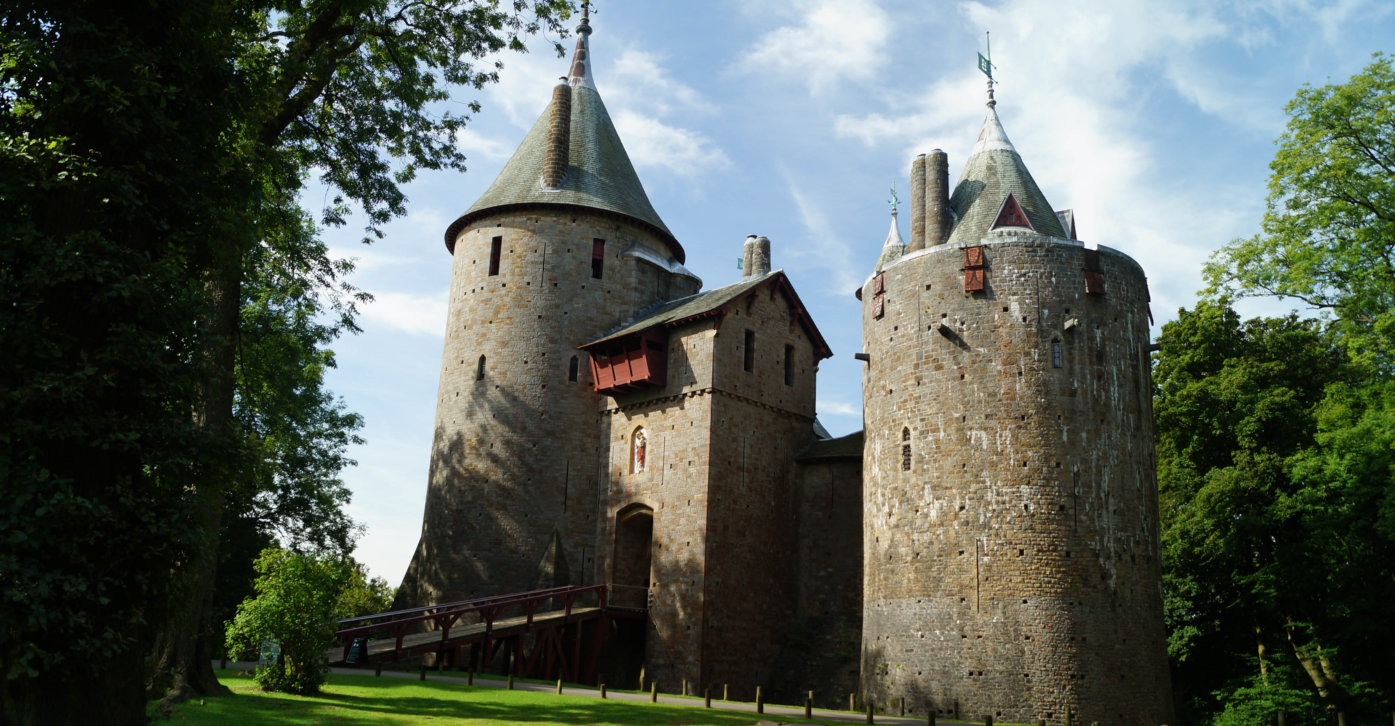
Sights
Castle Coch
Castle Coch is a 19th century Gothic Revival castle.

Slide 10
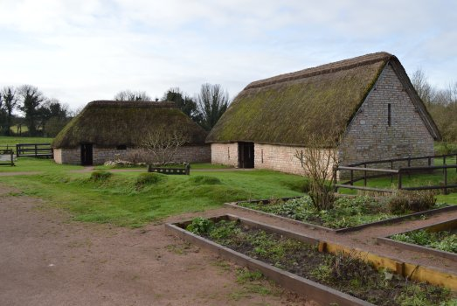
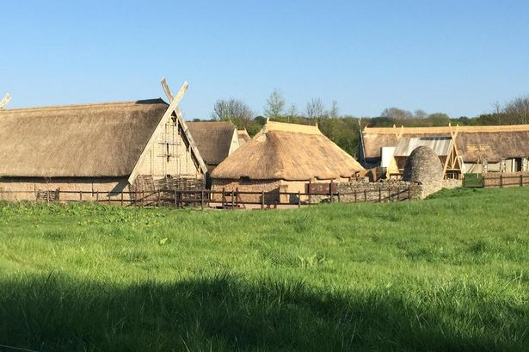
Sights
The Cosmeton Museum
The remains of the medieval village of Cosmeton were restored recreating the village as it might have looked over 600 years ago.

Slide 11
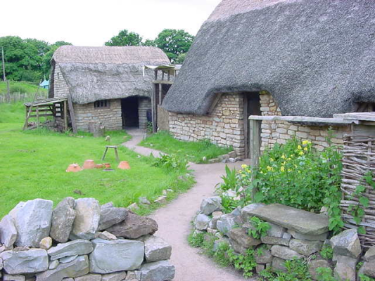
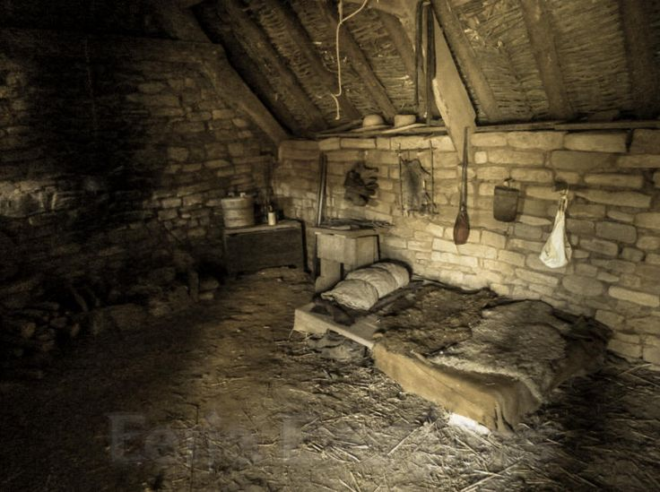
Sights
The Cosmeton Museum
There is a Reeve’s Cottage, Barn, and Byre, arranged around a courtyard.

Slide 12

Conclusion
The atmosphere of this city is pleasantly relaxed and pacifying. Here you can enjoy the beauty of local attractions and relax in quiet cafes, or you can bump into outdoor activities and visit a variety of excursions. Cardiff is friendly to tourists. Therefore, having decided to visit the UK, it is necessary to visit Cardiff.

Slide 13
Questions for revision:
In what year did Cardiff become the capital of Wales?
What is the most important landmark of the city?
Which of the Cardiff theaters was shown in the presentation?

Slide 14
Cardiff Alekseev Aleksey Alekseevich 2018

