Slide 1
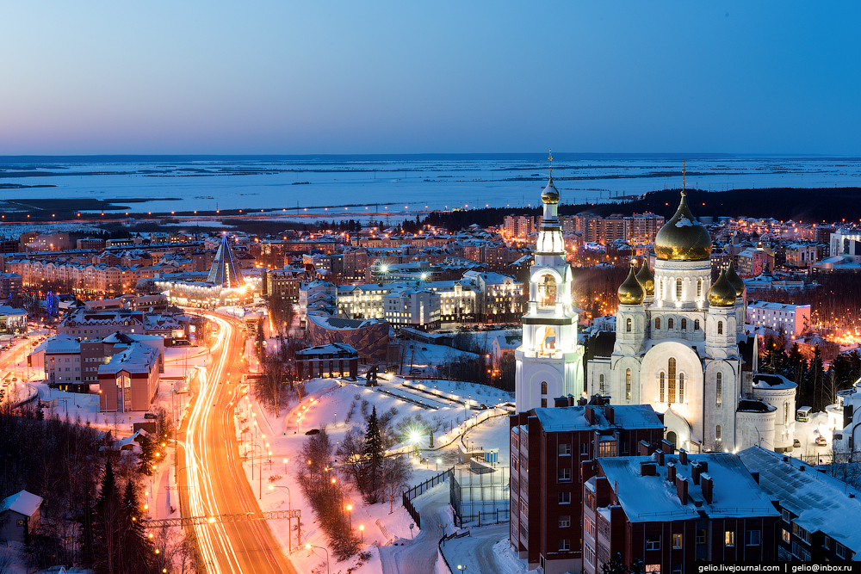
Responsible tourism in Khanty-Mansiysk
Автор: Шиповалова алина
Ооо центр развития «лингвомир»
2018

Slide 2
Presentation content
Environmentally-friendly means of transport;
Traditional accommodation;
Hand-made souvenirs;
Local people;
Flora and fauna of the region;
Aboriginal cuisine;
Recycling.

Slide 3
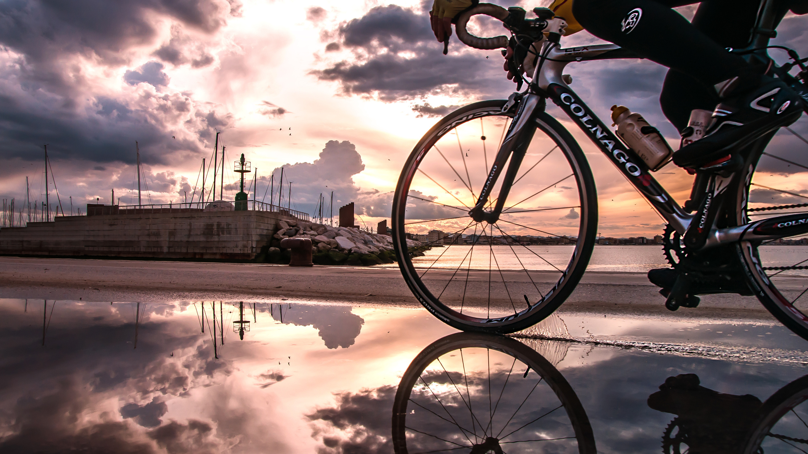
Transport
In summer you can use environmentally-friendly transport like bicycles, scooters and others, or you can just walk. In winter you can walk too if you are not afraid of cold. As it is a small city you can get anywhere quickly and easily.

Slide 4
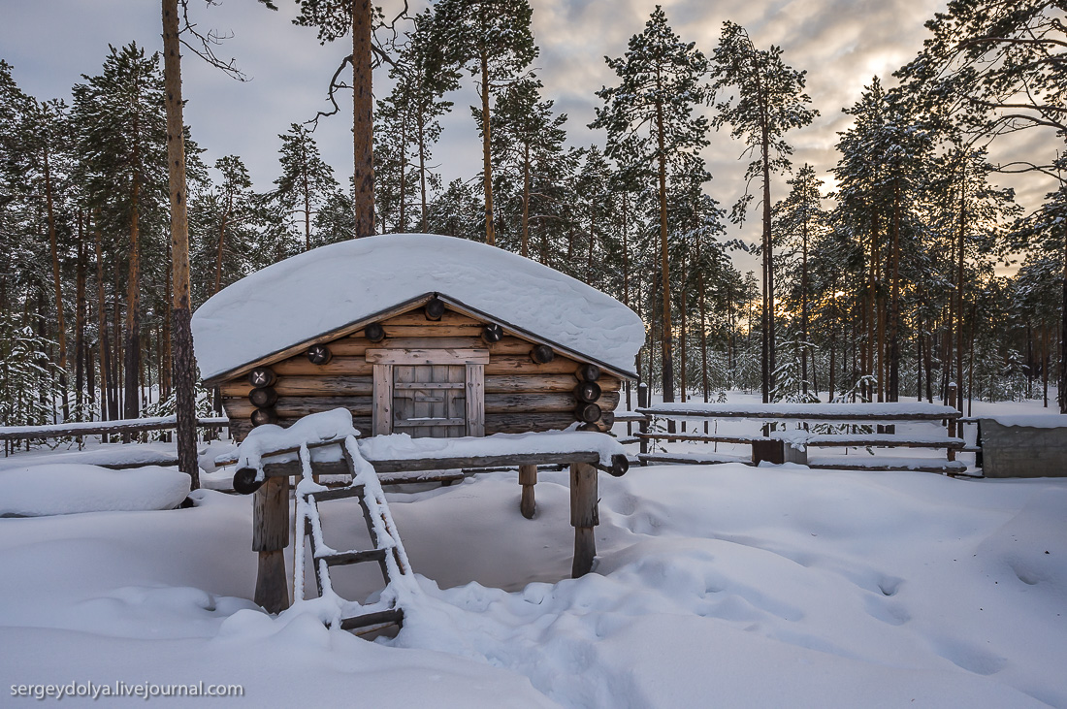
Accommodation, energy and water
We don’t have many options for environmentally-friendly accommodations. However, you can always try living in a traditional house of locals, where you, of course, save water, light and electricity.

Slide 5
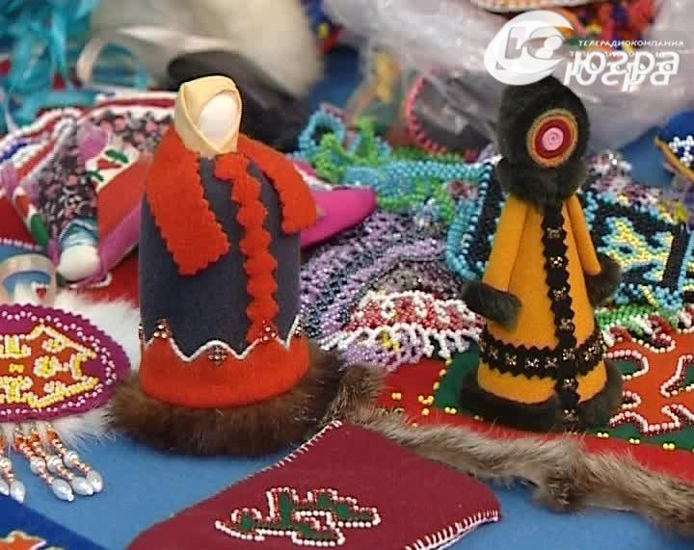
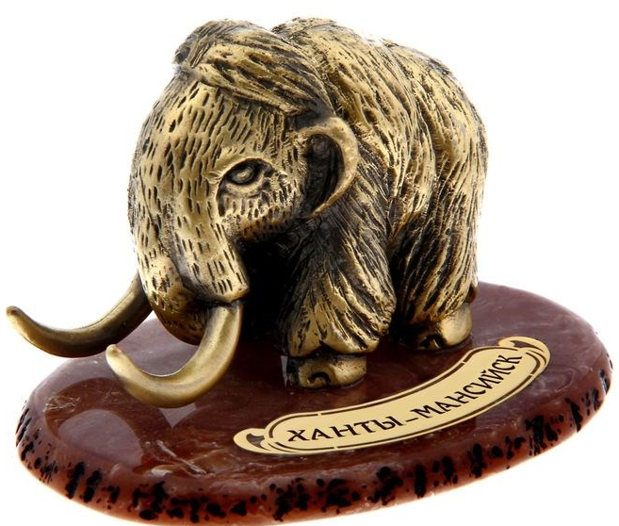
Souvenirs
You can purchase various statuettes, hand-made dolls that are decorated with the symbols of Ugra (made by local indigenous people) and figures in the form of mammoths. They are made from safe materials, so they don’t harm nature.

Slide 6
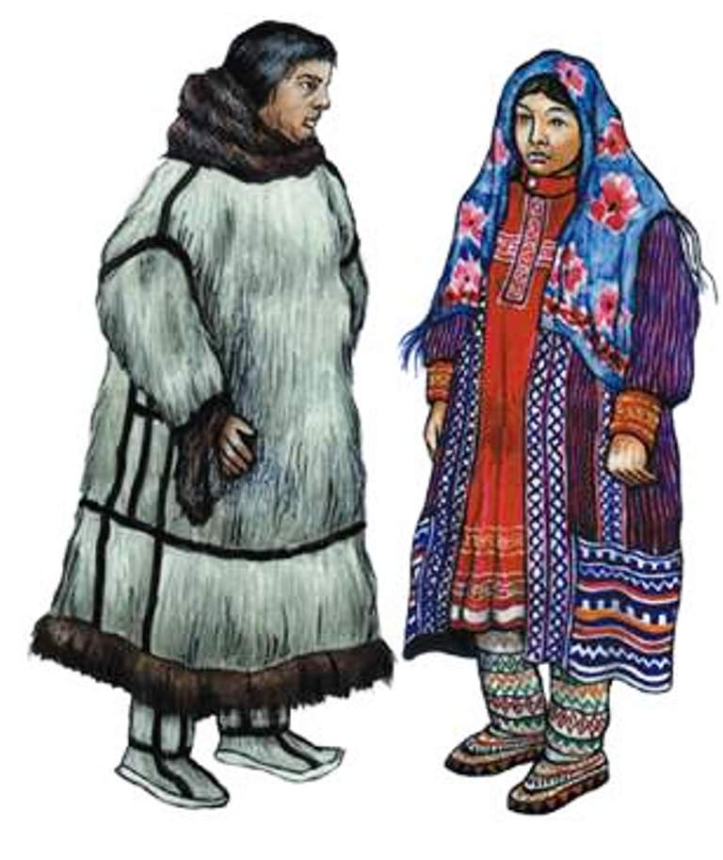
People and social interaction
The local population is friendly, hardworking and always ready to help. The indigenous population is also friendly and welcoming, and, it’s really interesting to see how they keep their customs and traditions safe.

Slide 7
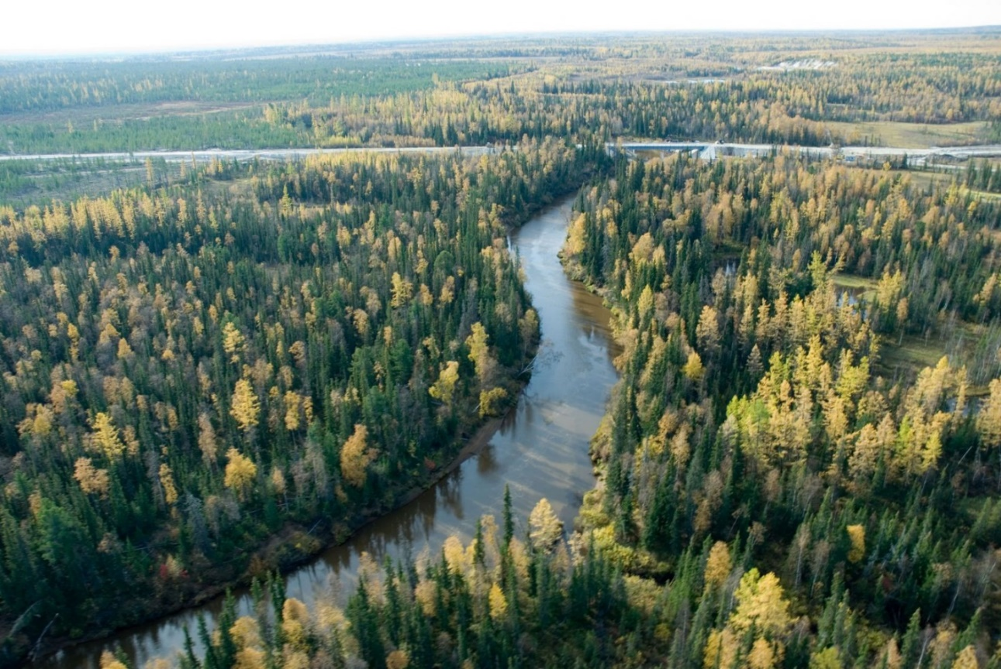
Flora and fauna
Over 800 species of various representatives of flora grow in the district. In the northern subzone of the taiga - swampy part of Ugra, cedar, spruce and larch predominate. Often in this area you can also find pine and birch. The peculiarities of the territory are the alternation of wetlands and peatlands with forests.

Slide 8
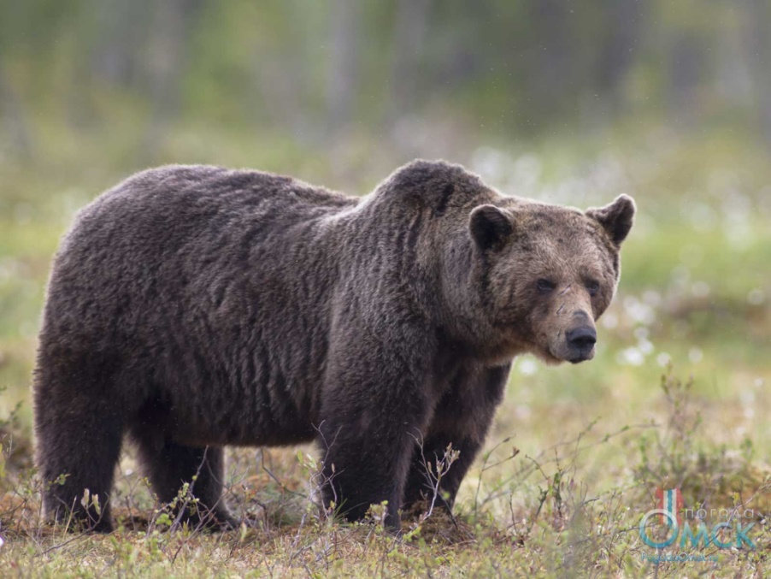
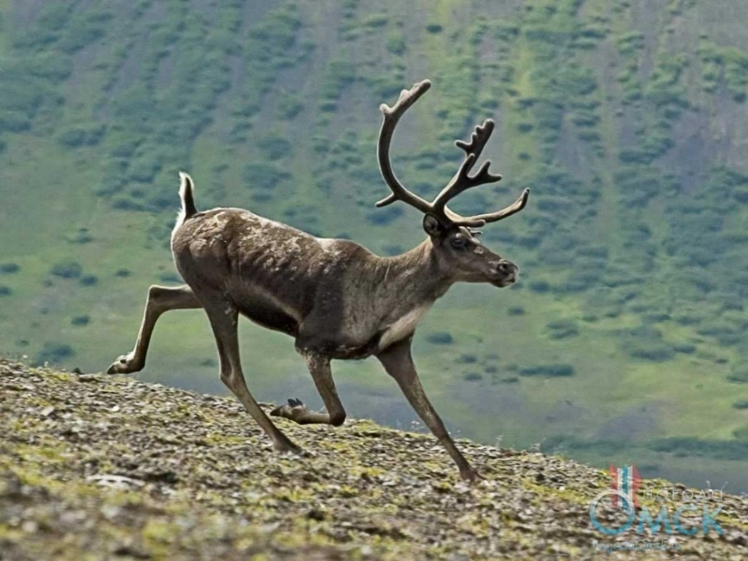
The Fauna of mammals of the district can be called the typical taiga complex. Here you can meet representatives of more than 60 different species, 16 of which are predators. Elks, deer, wild boars, foxes, ermines, squirrels, martens and many other animals get along safely throughout the taiga. The largest and most ferocious resident of the district is the brown bear, which many people call the "master" of the taiga.

Slide 9
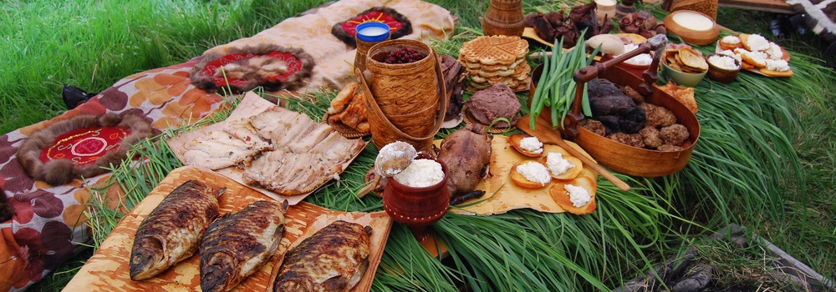
Food
You can visit various restaurants where the main feature is a large number of different meat and fish products and dishes. But don’t do it often, because someday the fish may just disappear.

Slide 10
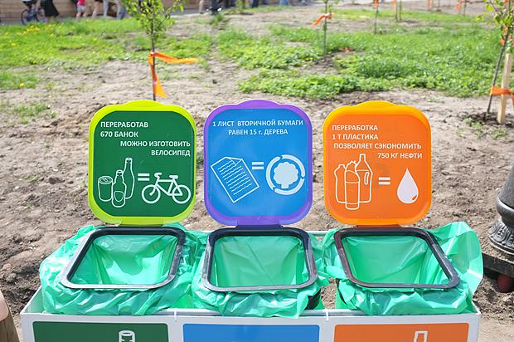
Recycling
There are many special containers for recycling where you can pick up trash. Do not throw trash anywhere, as it harms nature.

Slide 11
conclusion
Being environmentally-friendly while travelling is extremally important, because we are responsible for the nature that was given to us. It is our liability to save what we have and let it thrive, rather that destroy it;
In our modern society there is no problem in finding information about eco-tourism. Even in such harsh conditions and distant regions like Khanty-Mansiysk Autonomous Okrug you can travel without harming nature;
I would like everyone to be more responsible for their action, because I want us living on the clean planet.

