Slide 1
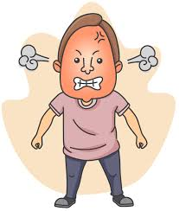
He looks furious!

Slide 2
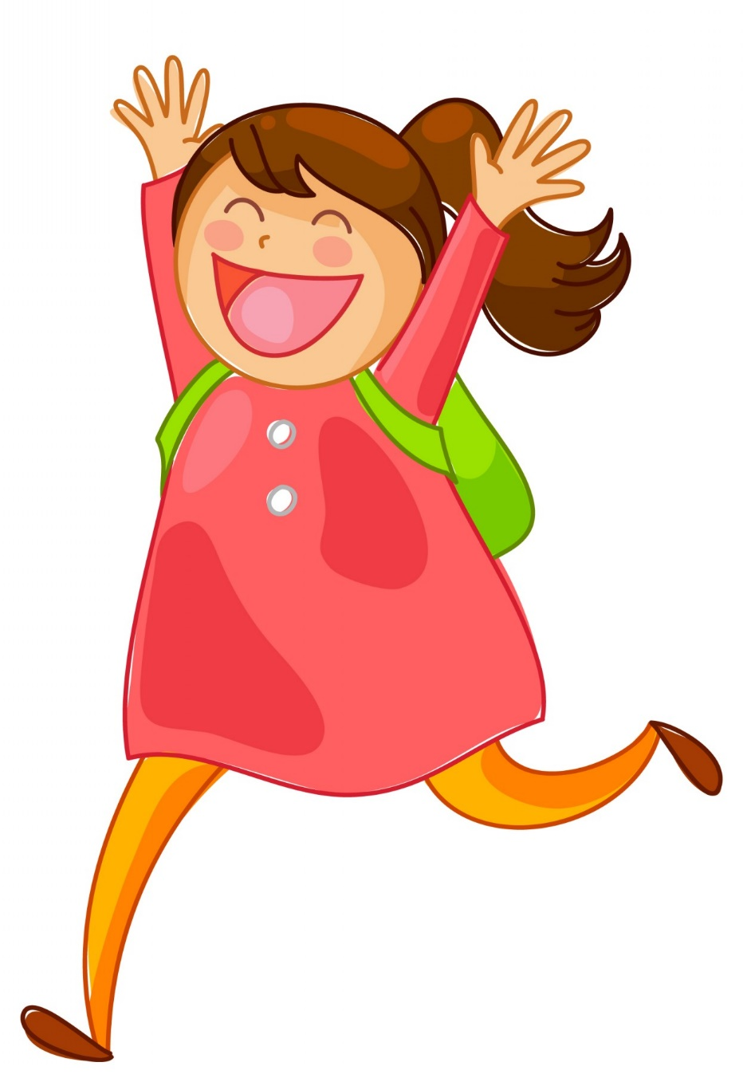
She looks happy (cheerful).

Slide 3
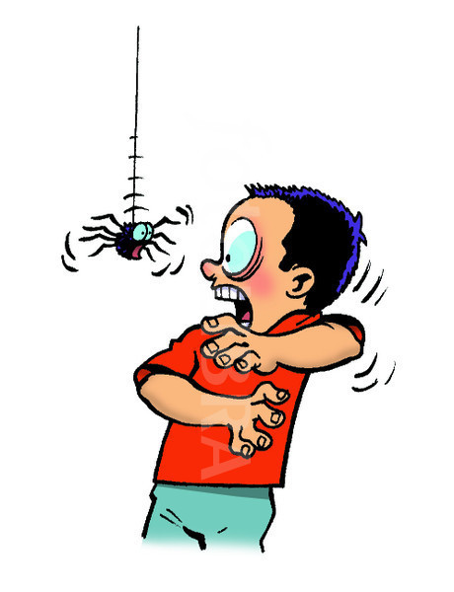
He looks frightened (scared)!

Slide 4

It looks embarrassed (confused).

Slide 5
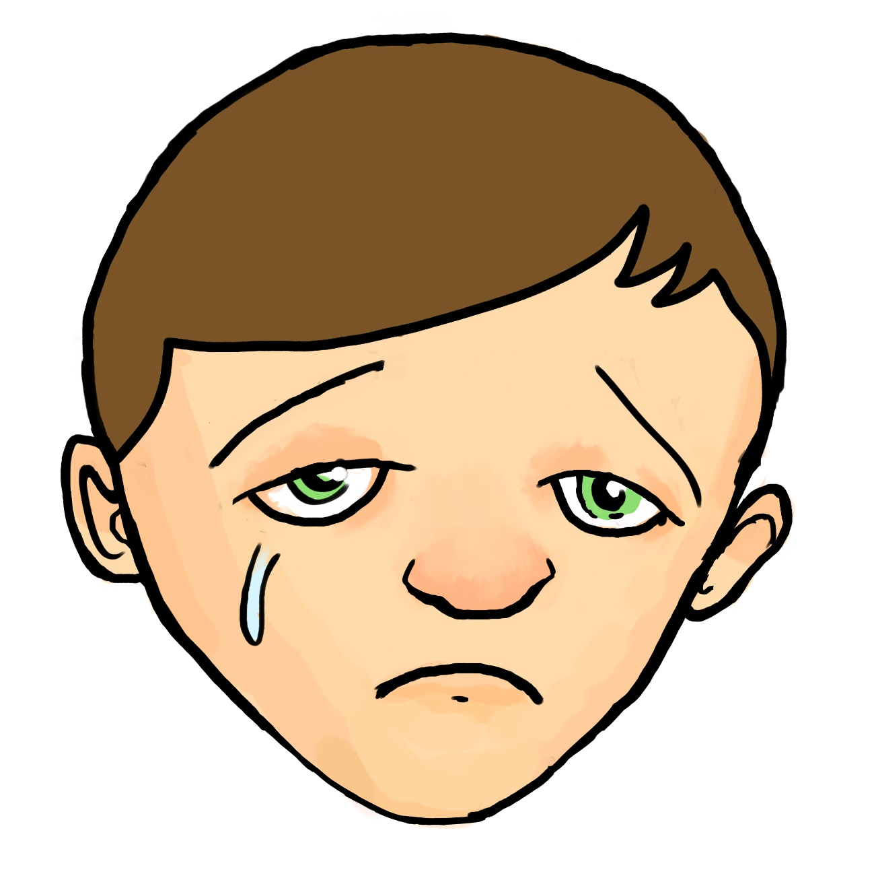
He looks sad (upset).

Slide 6
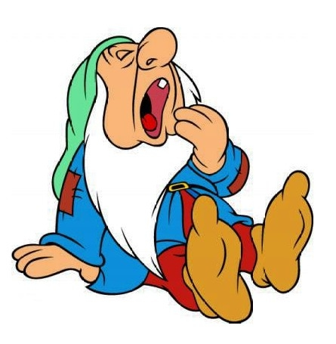
A gnome looks sleepy.

Slide 7
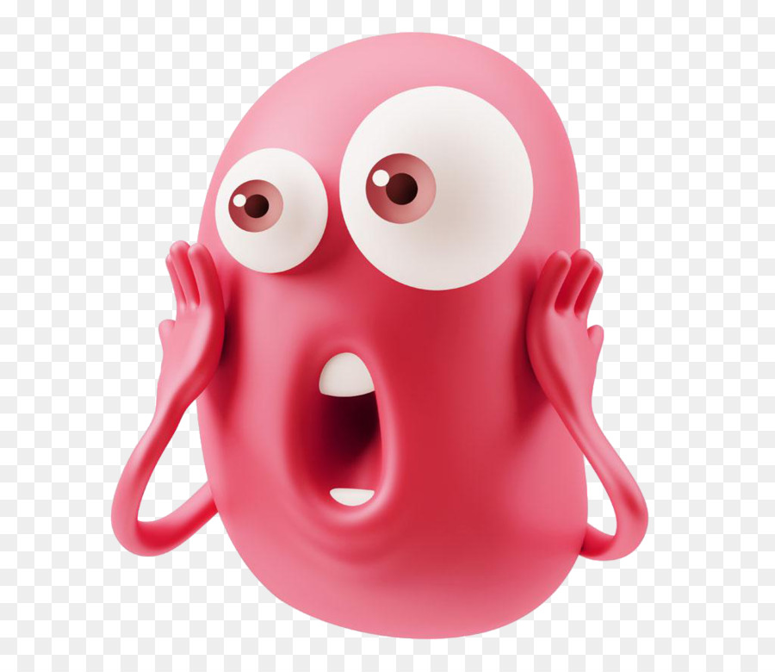
A child looks surprised.

Slide 8
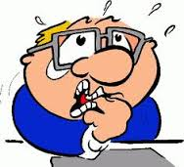
He looks nervous.

Slide 9
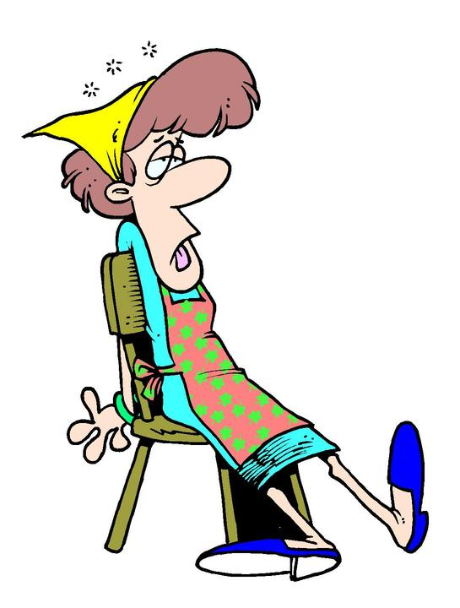
She looks tired (exhausted).

Slide 10
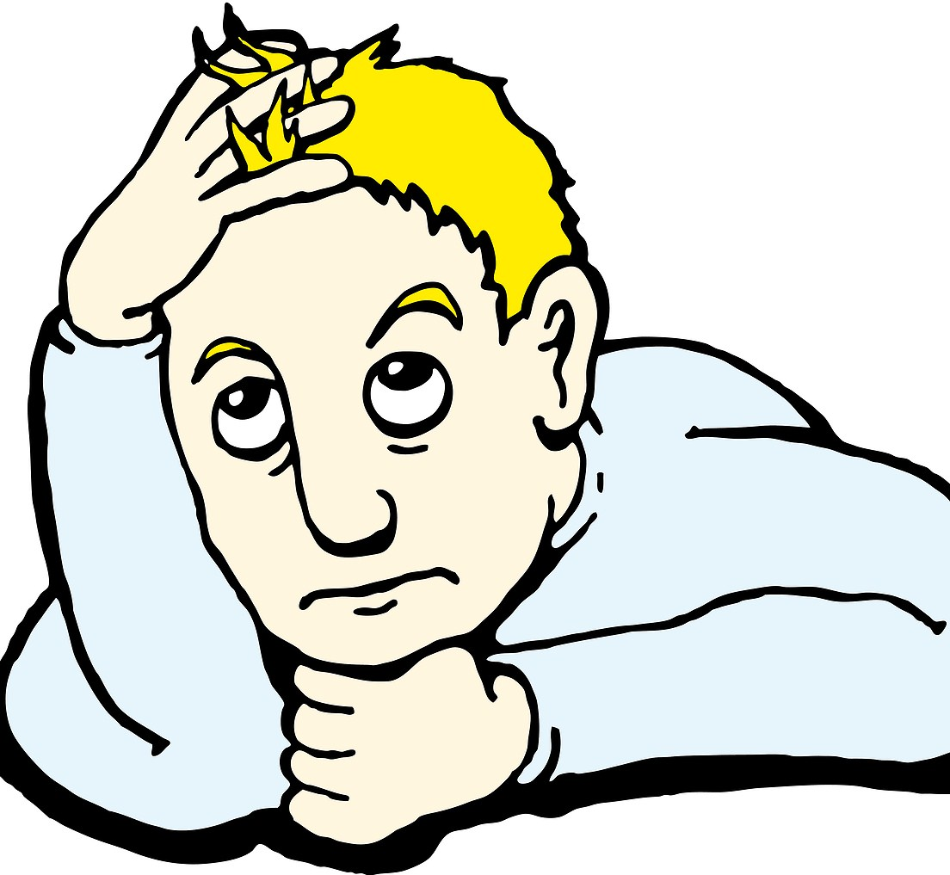
He looks bored.

Slide 11
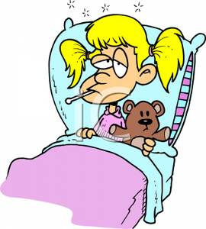
She looks ill (sick).

