Slide 1
Have you ever?

Slide 2


Have you ever + V-3/V+ed ?
Have you ever been to Egypt?
Yes, I have (been to Egypt).
No, I haven’t.
No, I have never been to Egypt.
Have you ever cooked pizza?
Yes, I have (cooked pizza).
No, I haven’t.
No, I have never cooked pizza.

Slide 3

Example:
Student 1. Lena, have you ever seen a ghost?
Student 2. No, I have never seen a ghost.

Slide 4
Useful irregular verbs:
be – was/were – been
see – saw – seen
drive – drove – driven
swim – swam – swum
read – read – read
learn – learnt – learnt
teach – taught – taught
make – made – made
eat – ate – eaten
ride – rode - ridden

Slide 5


Slide 6


Slide 7



Slide 8


Slide 9


Slide 10
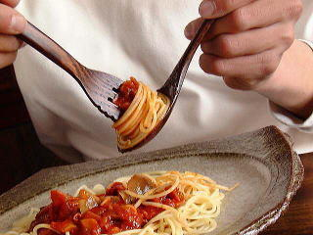

Slide 11


Slide 12
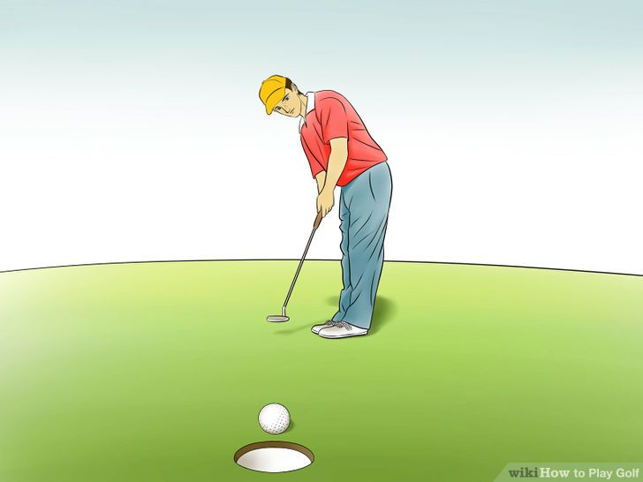

Slide 13


