Slide 1
What are their jobs?

Slide 2
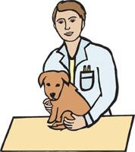
He is a vet. He helps sick animals.

Slide 3

He is a doctor. He cures people.

Slide 4
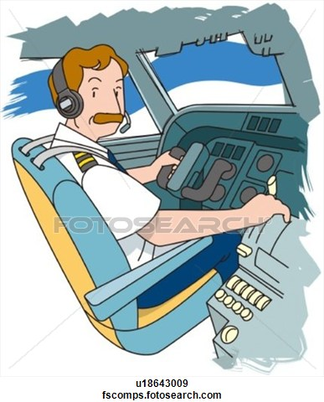
He is a pilot. He flies a plane.

Slide 5
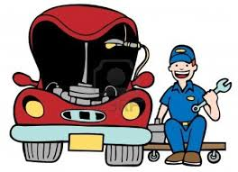
He is a mechanic. He fixes cars.

Slide 6
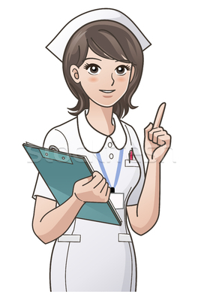
She is a nurse. She helps doctors.

Slide 7
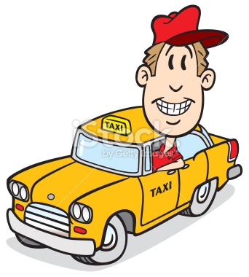
He is a taxi driver. He drives a taxi.

Slide 8

He is a police officer. He catches thieves.

Slide 9
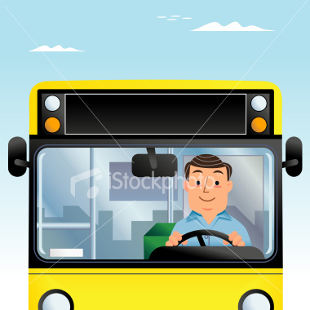

He is a bus driver. He drives a bus.

Slide 10

She is a shop assistant. She sales clothes.

Slide 11
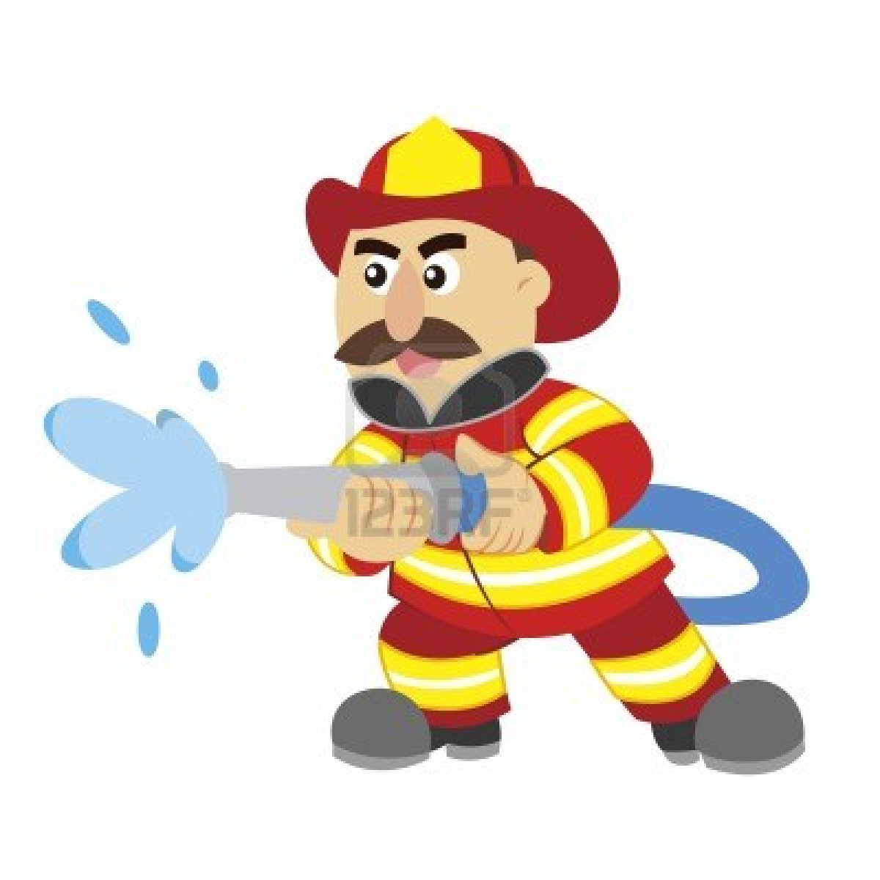
He is a firefighter. He puts down fire.

Slide 12
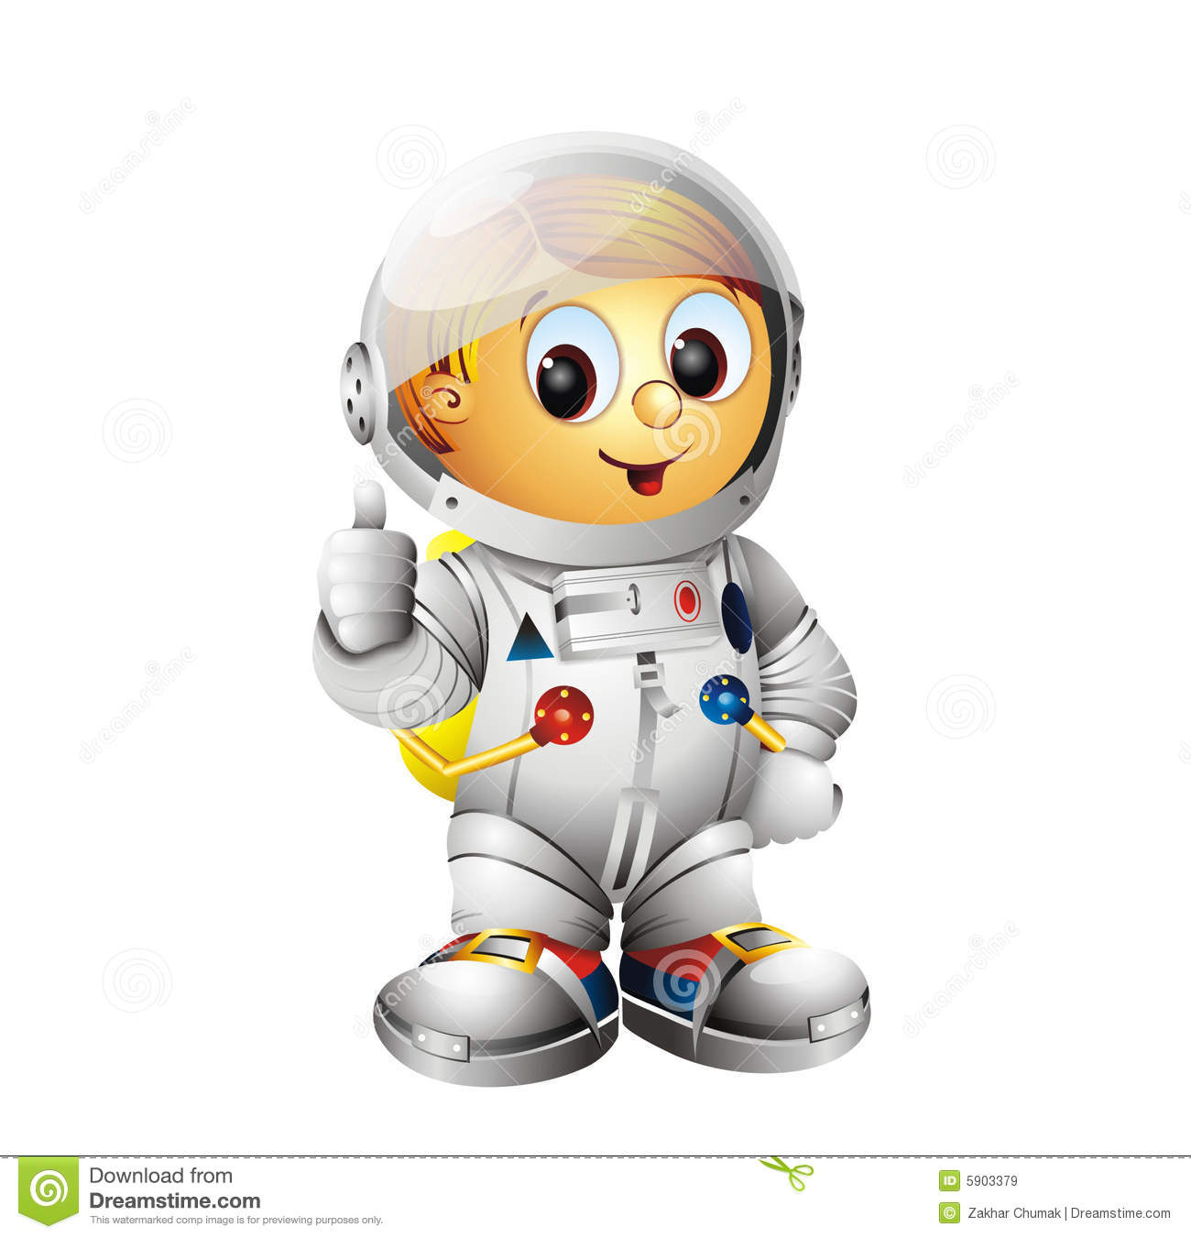
He is an astronaut. He explores space.

Slide 13
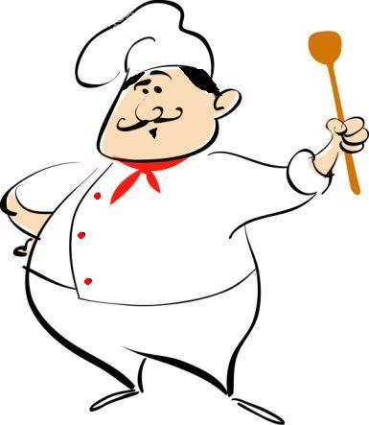
He is a chef. He cooks food.

Slide 14
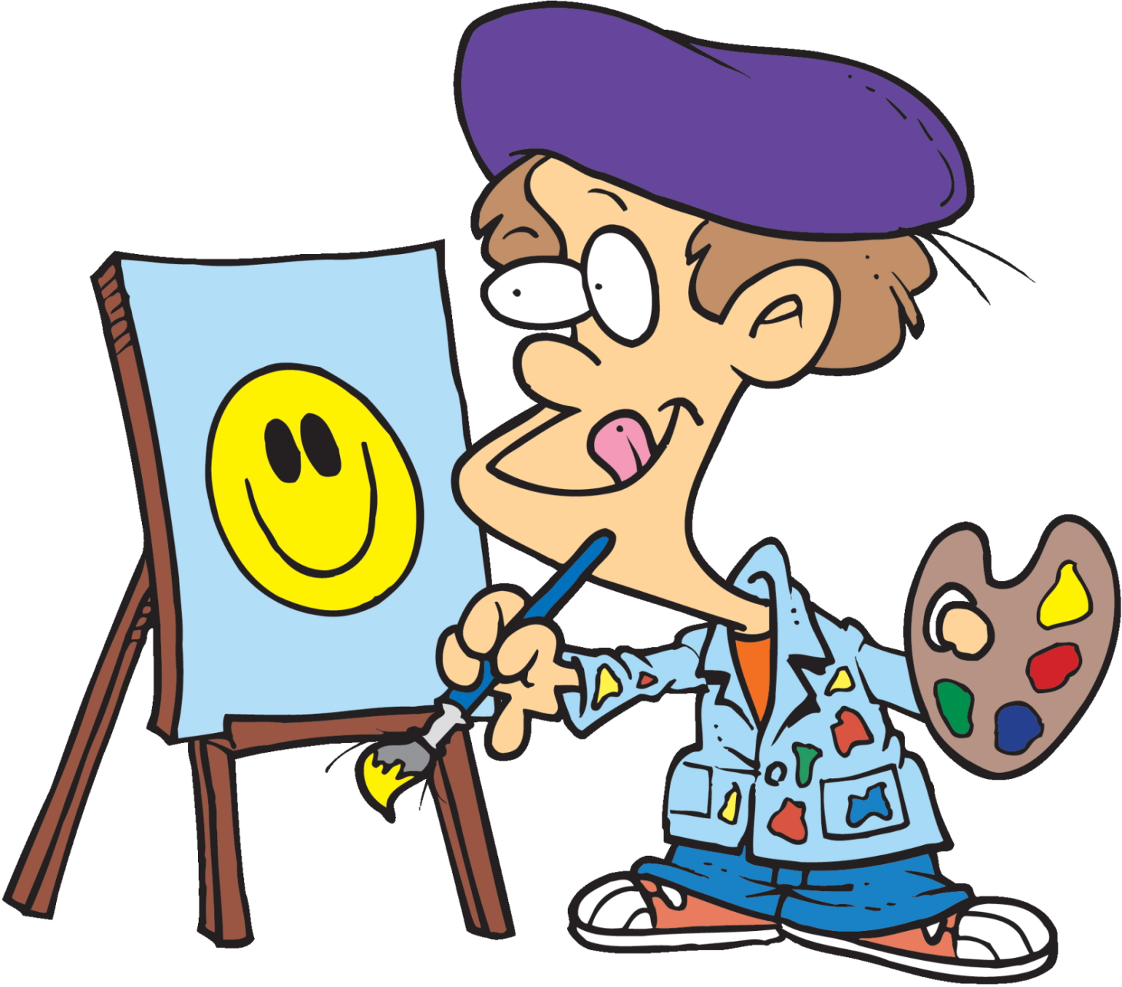
He is an artist. He creates pictures.

Slide 15
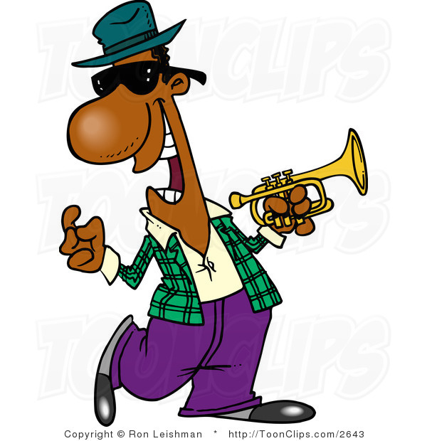
He is a musician. He plays music.

Slide 16
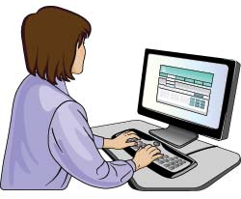
She is a programmer. She runs a computer.

Slide 17
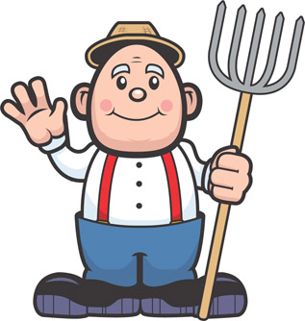
He is a farmer. He grows vegetables.

Slide 18
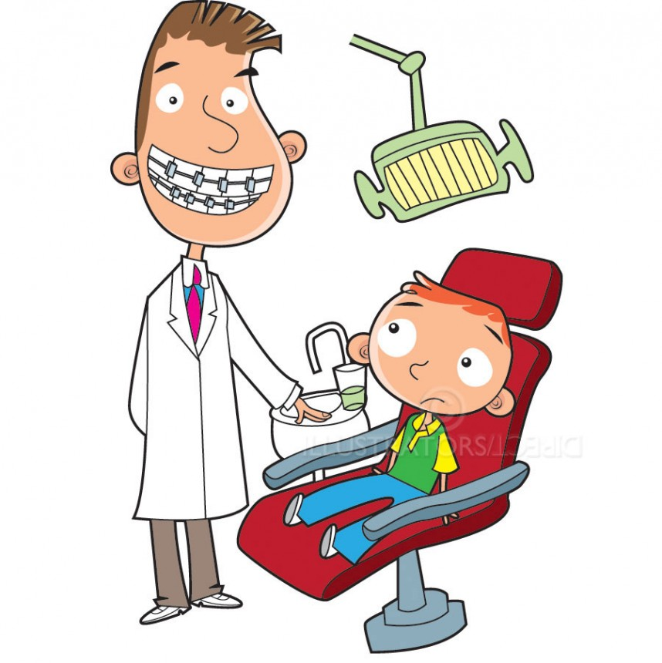
He is a dentist. He fixes teeth.

Slide 19

He is a postman. He delivers letters.

