Slide 1

Welcome to the 6th form!
Благинина Екатерина Александровна,
Учитель английского языка,
МОУ СОШ №10 им. В.П.Поляничко, г. Магнитогорск
Калейдоскоп педагогических новаций - 2018

Slide 2




Welcome
September is here
And so is fall.
So welcome children
Welcome all.
I hope vacation
Was real fun.
And that you're glad
School has begun.

Slide 3




Welcome
September is here
And so is fall.
So welcome children
Welcome all.
I hope vacation
Was real fun.
And that you're glad
School has begun.

Slide 4
Clothes
Shops
Food
Let’s remember!
Some/any
Much/many
Types of films

Slide 5
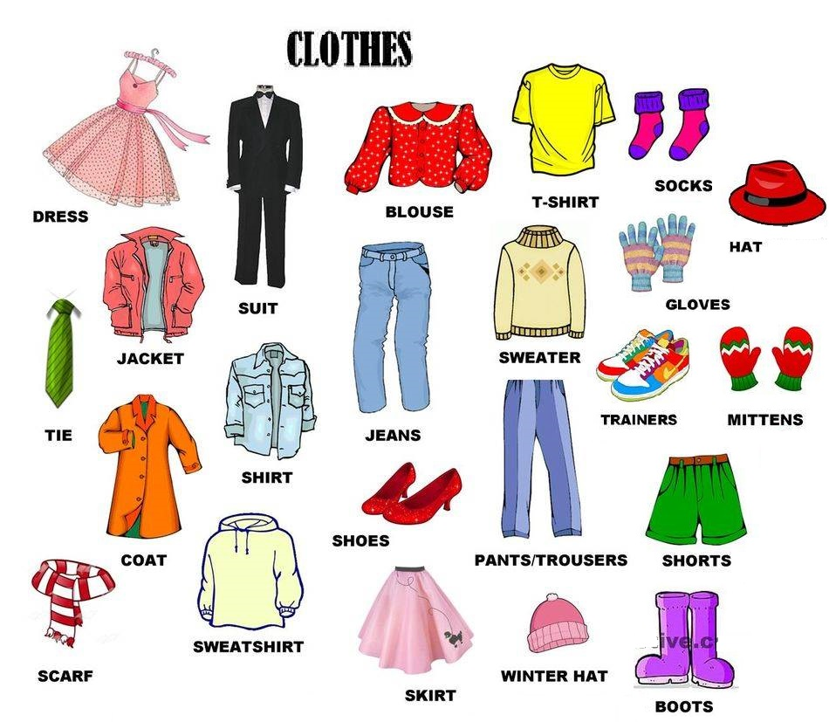

Slide 6
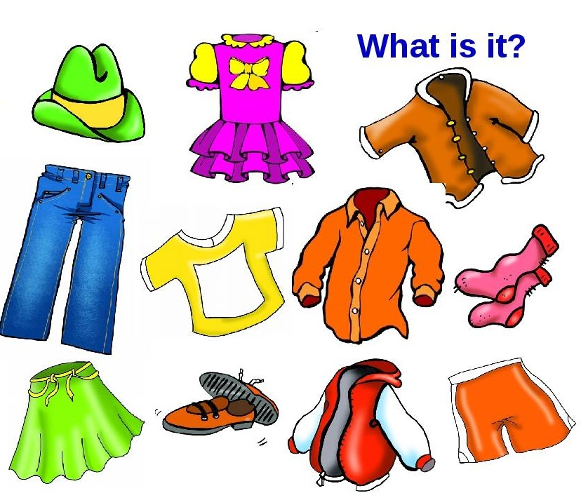
jacket
coat
socks
shorts
hat
T-shirt
skirt
dress

Slide 7
Find 10 words.
S | Q | D | R | E | S | S | W | S | S
W | W | Z | A | P | J | D | S | H | O
E | J | A | C | K | E | T | J | O | C
A | A | S | S | P | D | M | R | R | K
T | D | C | R | H | H | T | U | T | S
E | G | E | F | D | O | I | I | S | P
R | S | U | I | T | V | R | D | E | W
R | E | A | B | O | Z | A | T | G | A
G | T | R | A | I | N | E | R | S | R
P | T | R | O | U | S | E | R | S | E

Slide 8
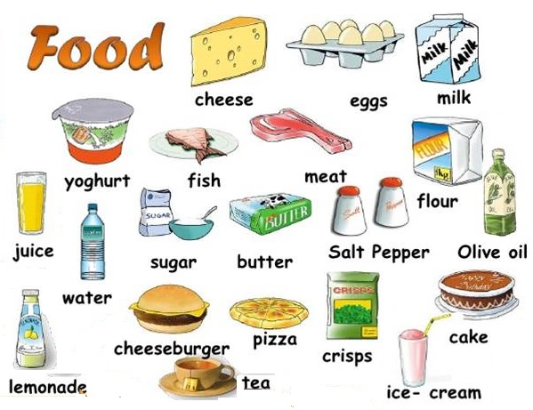

Slide 9

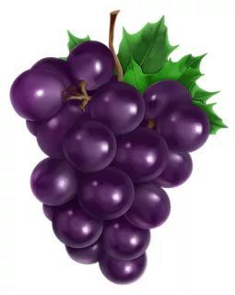
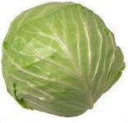

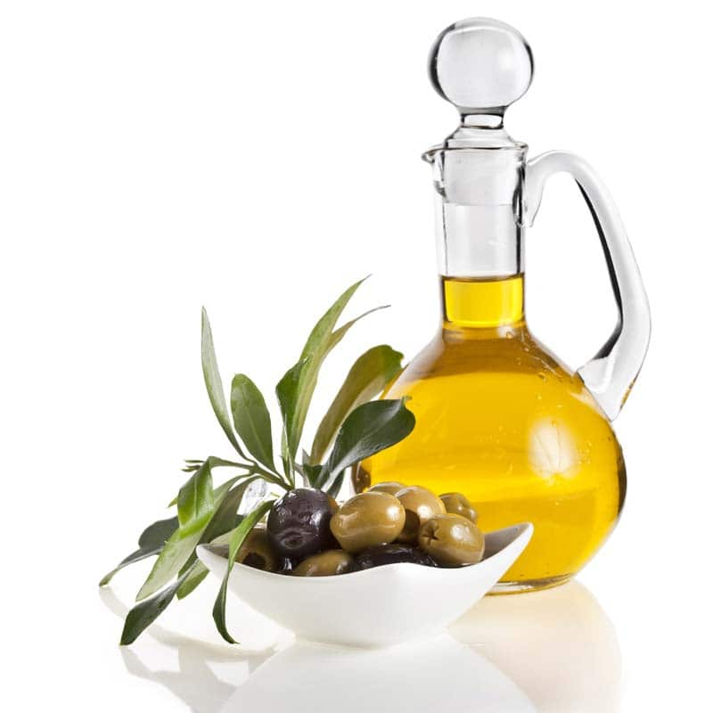
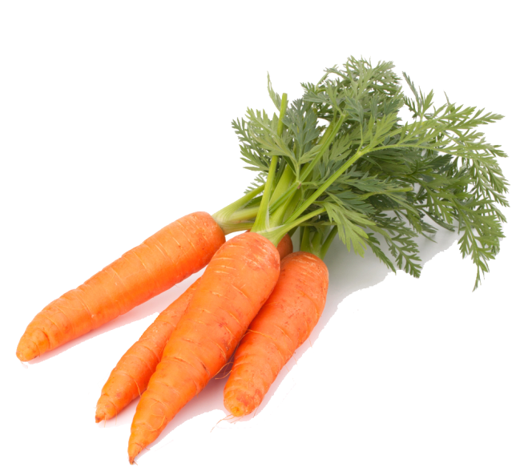
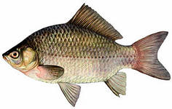



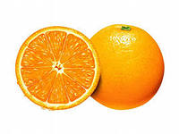
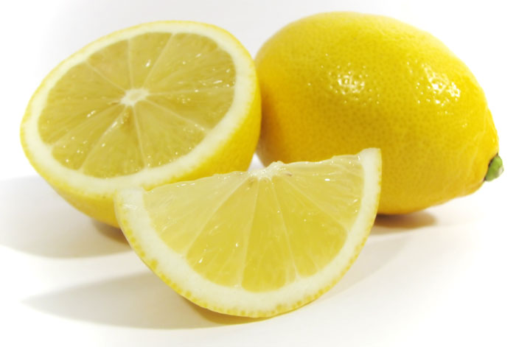
What is it?

Slide 10

"Find the word"
psugartrkll
lkxbutterey
watertuert
lkrupepper
gtchipstaff
dmeatsillpz
goliveoilmit
byeghjuicen

Slide 11


Slide 12

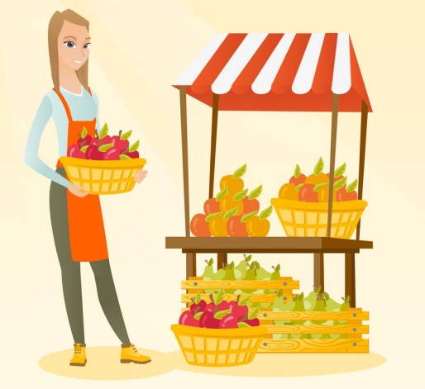





What is missing?

Slide 13




Types of films
A horror film
A romance
A comedy
An action film
An animated film
An adventure film

Slide 14
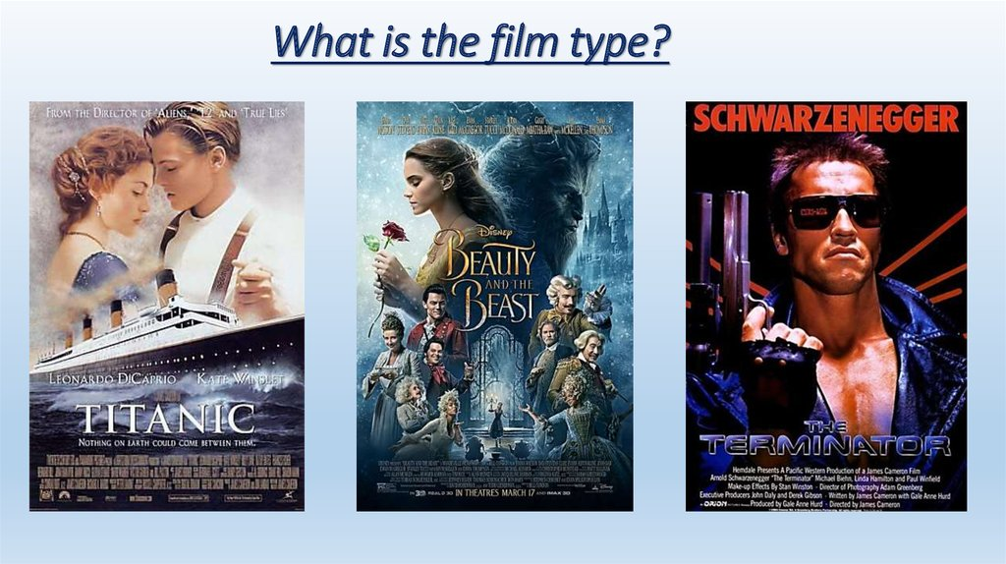

Slide 15
Many/ much – много
How many/how much - сколько
many
much
 | Countable | Uncountable
+ | A lot of | A lot of
- | many | much
? | How many…? | How much…?
much
many
a lot of
a lot of
Much, many, a lot of
There are ………………. apples in the vase.
There isn’t …………….. sugar on the plate.
There aren’t ……..……..eggs in the fridge.
How …………………… coffee are there?
How …………..………. peppers are there?

Slide 16

Немного
any
some
any
some
any
some
We haven’t got ________ rice at home.
Is there ________ juice on the table?
Give me ________ cheese please.
There isn’t __________ butter in the fridge.
My friend has got __________ sweets.
Are there ________ pupils in the classroom?
Would you like _________ tea?
any

Slide 17
Интернет-ресурсы:
источник шаблона:
Фокина Лидия Петровна
учитель начальных классов
МКОУ «СОШ ст. Евсино»
Искитимского района
Новосибирской области
Картинки
https://www.euroki.org/system/books/covers/000/002/473/thumb/cover.jpg?1499107530
https://img-fotki.yandex.ru/get/4805/200418627.1/0_105f96_8e551457_orig.png
https://ds04.infourok.ru/uploads/ex/0917/00112016-ba73b090/hello_html_78c6f79.png
https://i.pinimg.com/736x/b6/db/b6/b6dbb62f5430f799e089a04d294e70b3--exercises-worksheets.jpg
https://ds03.infourok.ru/uploads/ex/03a6/0001ebed-39cc3536/img3.jpg
http://m.sweetclipart.com/wp-content/uploads/Little-Rain-Cloud-2-Clip-Art.png
https://ds03.infourok.ru/uploads/ex/0d31/00008260-ab38c8e0/img2.jpg
https://img-fotki.yandex.ru/get/6607/159303434.158/0_8651c_412ae82b_XL.jpg
http://wallpaperget.com/images/grapes-images-26.png
http://samshit-aroma.com/wp-content/uploads/2017/05/06d2a3c6-e58f-4970-8225-dae2ac8e4993.jpg
https://www.picpng.com/images/large/cherry-clipart-25348
https://hdwallpaperz.net/wp-content/uploads/2017/01/Apple-Pictures-1.jpg
http://clipart-library.com/image_gallery2/Carrot-PNG.png

