Slide 1


Slide 2
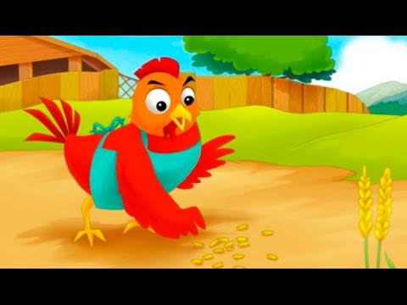
The little red hen finds some seeds.

Slide 3

Who can help me?

Slide 4
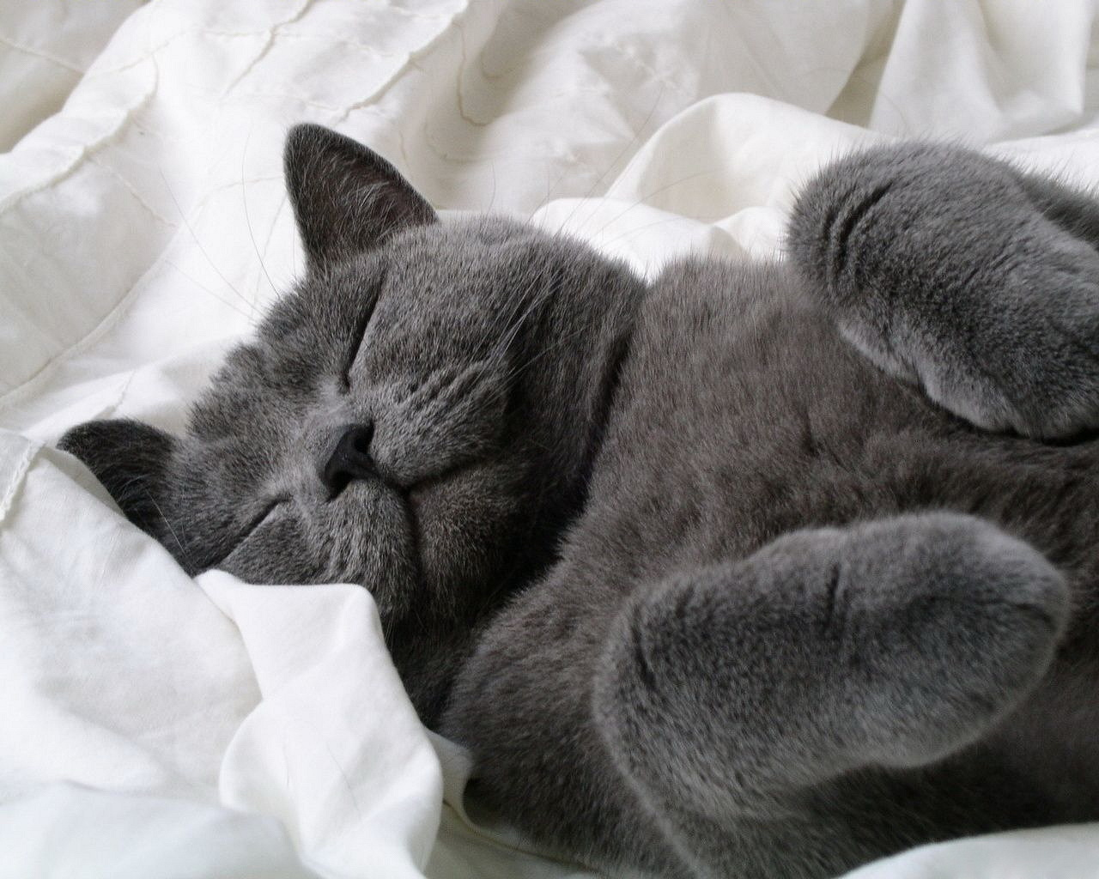
I can’t. I want to sleep.

Slide 5

I can’t. I want to play in the water.

Slide 6
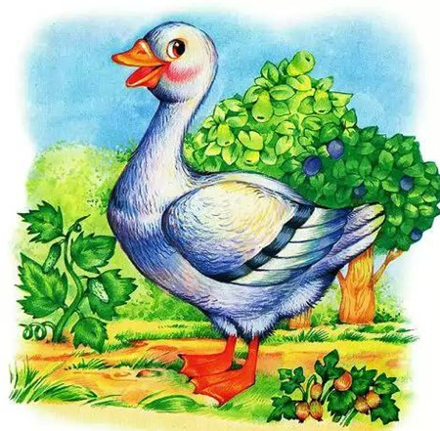
I can’t. I want to sit in the sun.

Slide 7

All right. I can plant the seeds.

Slide 8
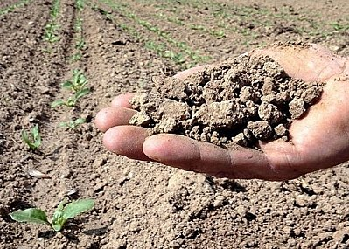
The seeds want water.

Slide 9
Who can help me?

Slide 10

I can’t. I don’t like water.

Slide 11
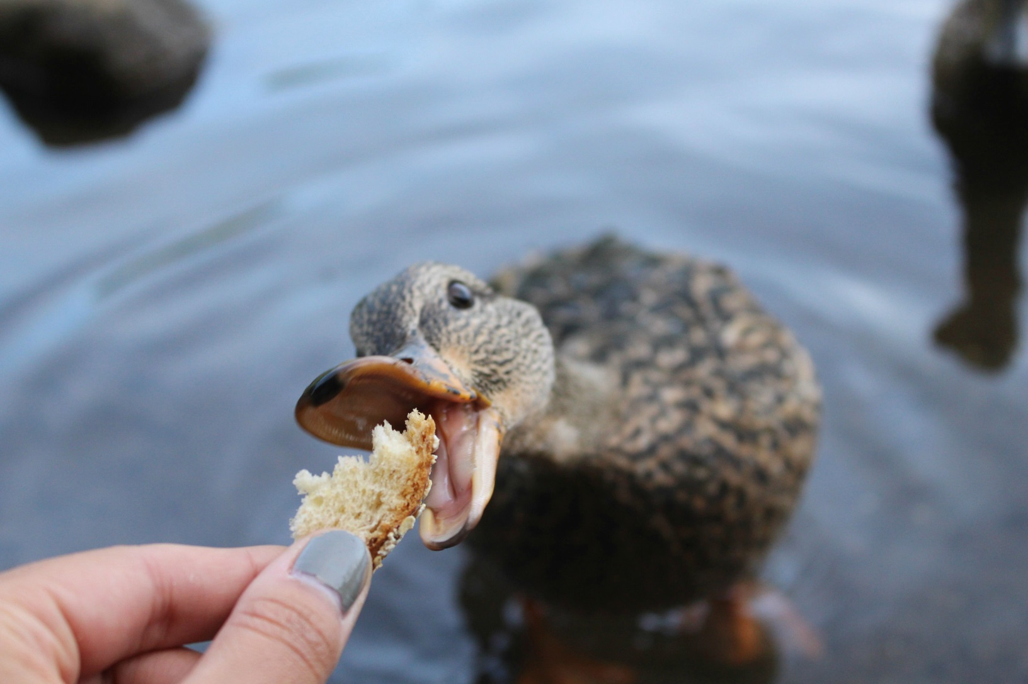
I can’t. I want my lunch.

Slide 12
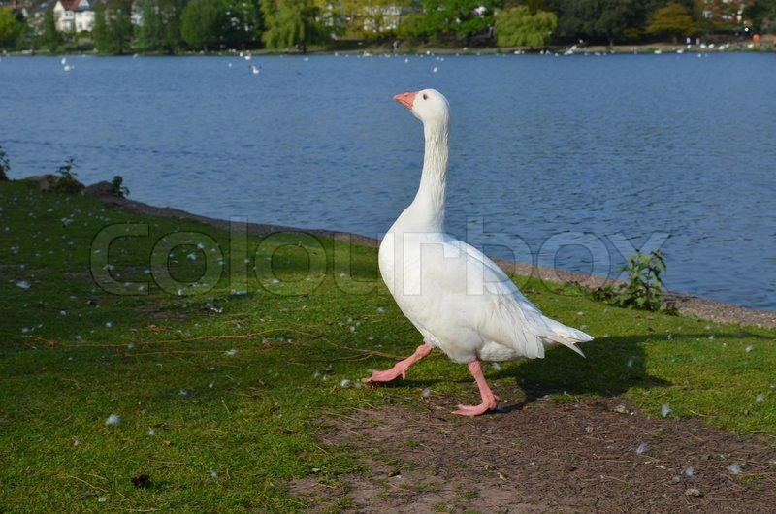
I can’t. I want a walk.

Slide 13
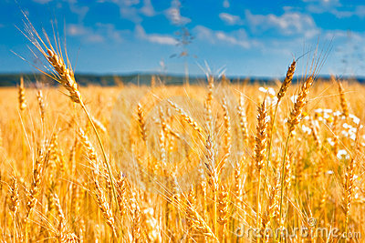
The sun is hot. The wheat is yellow.

Slide 14
We can cut the wheat. Who can help me?

Slide 15

I can’t. I want to play.

Slide 16
I can’t. I want my lunch.

Slide 17

I can’t. I want to play.

Slide 18
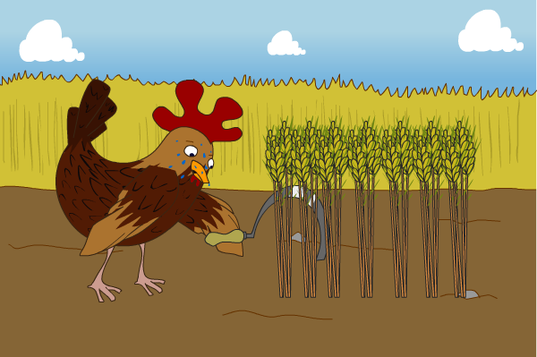
All right.

Slide 19
Let’s grind this wheat.

Slide 20

I can’t. I want some milk.

Slide 21
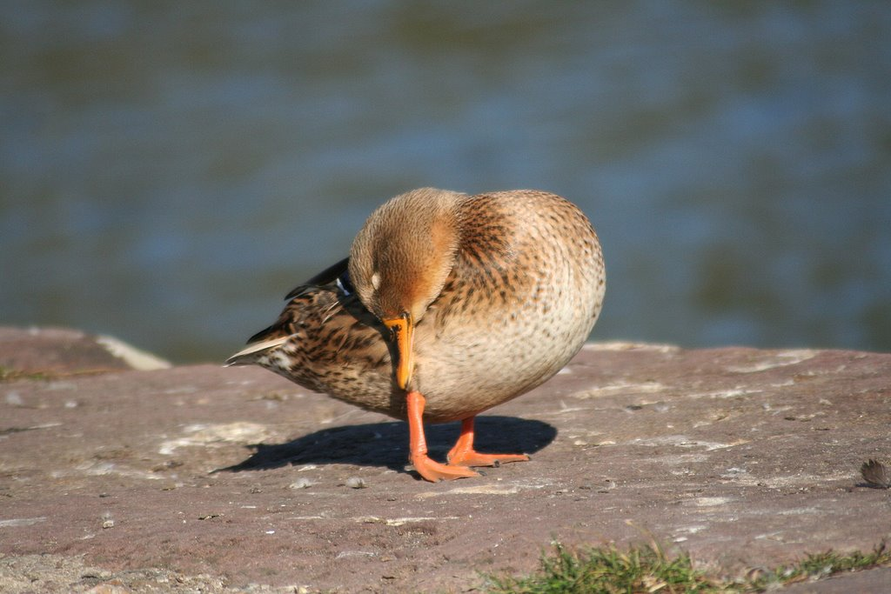
I can’t. I want to sleep.

Slide 22
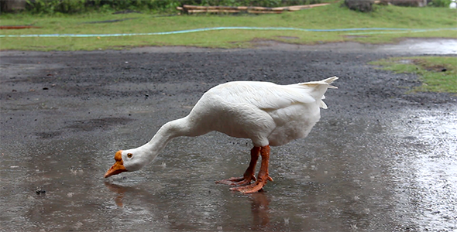
I can’t. I want a drink.

Slide 23
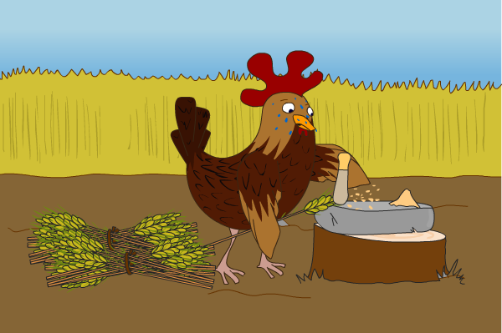
All right.

Slide 24
We can make some bread with this flour. Come on! Who can help me?

Slide 25
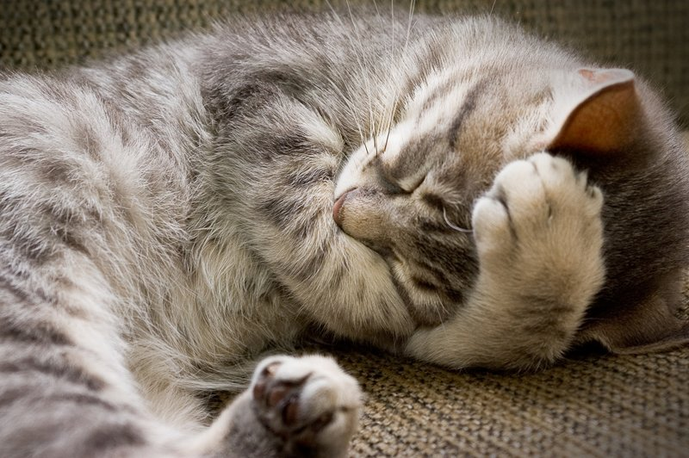
I can’t. I want to sleep.

Slide 26
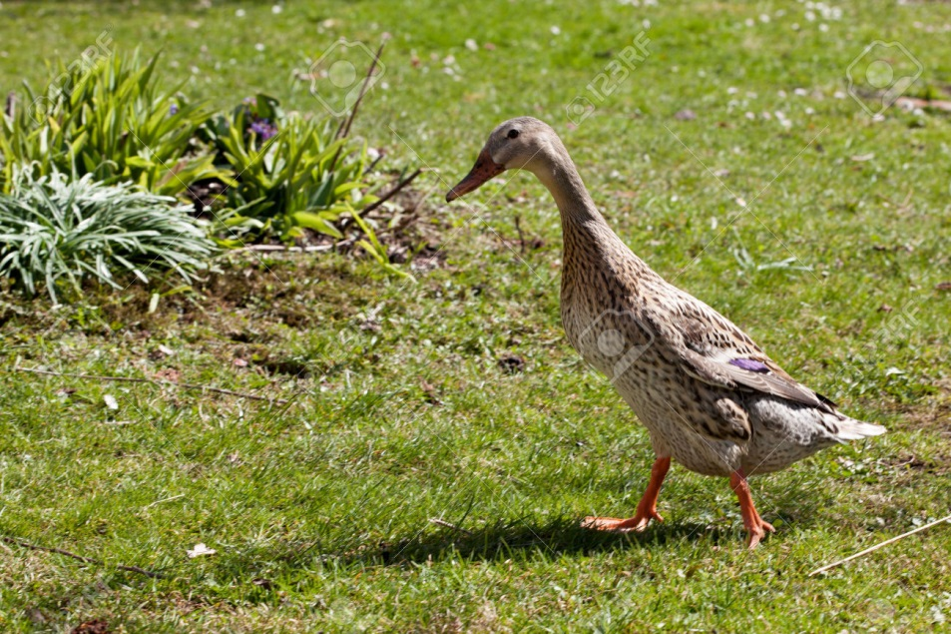
I can’t. I want to go in the garden.

Slide 27
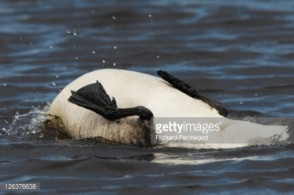
I can’t. I want to sit and wash.

Slide 28

All right. I can make the bread.

Slide 29
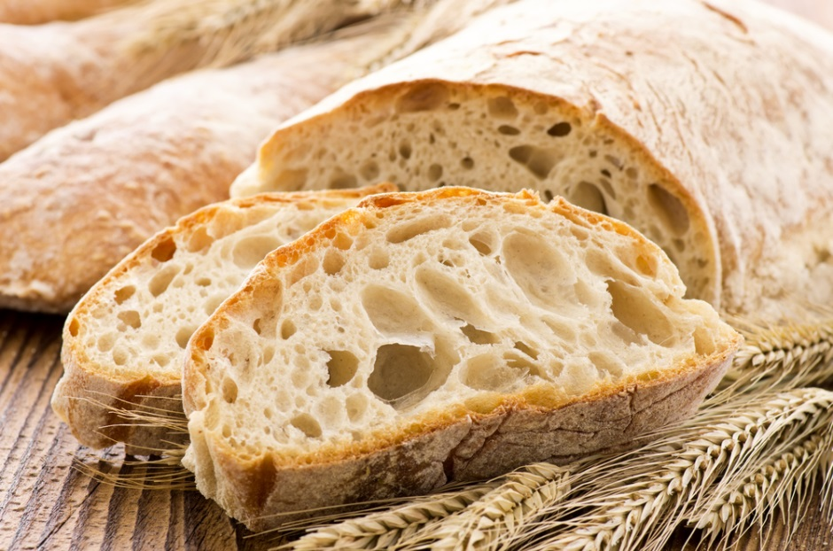
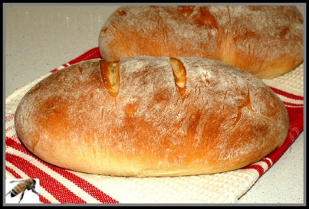
The bread looks good.

Slide 30

It’s time to eat the bread. Who can help me?

Slide 31

I CAN!

Slide 32
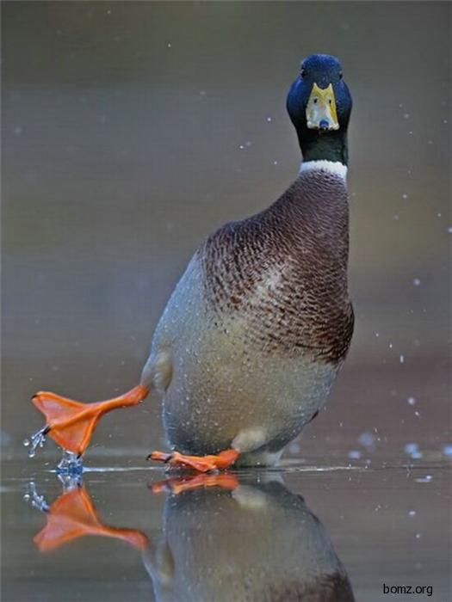
I CAN!

Slide 33
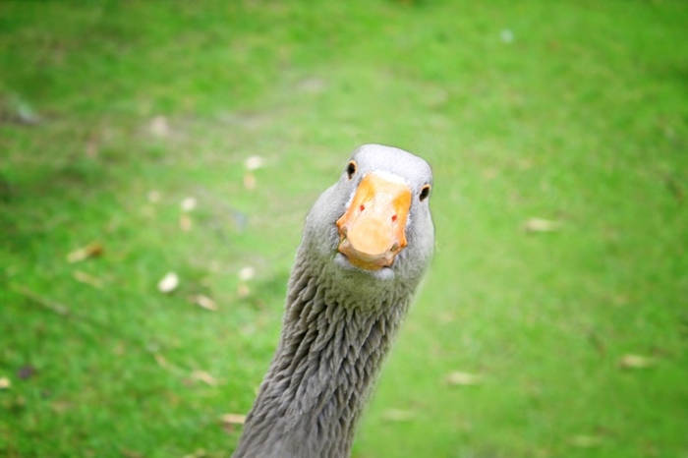
I CAN!

Slide 34
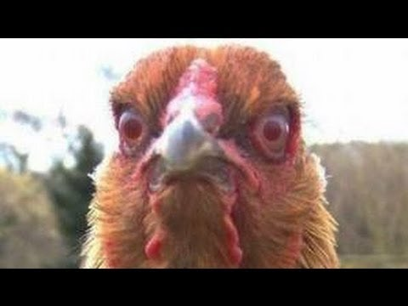
But the little red hen thinks…

Slide 35
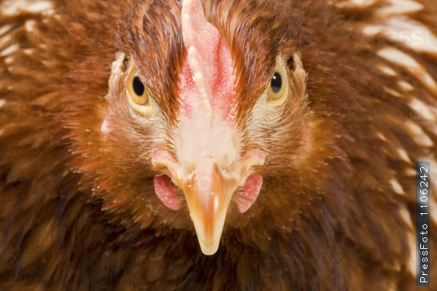
No you can’t! Off you go! Go away and play!

Slide 36
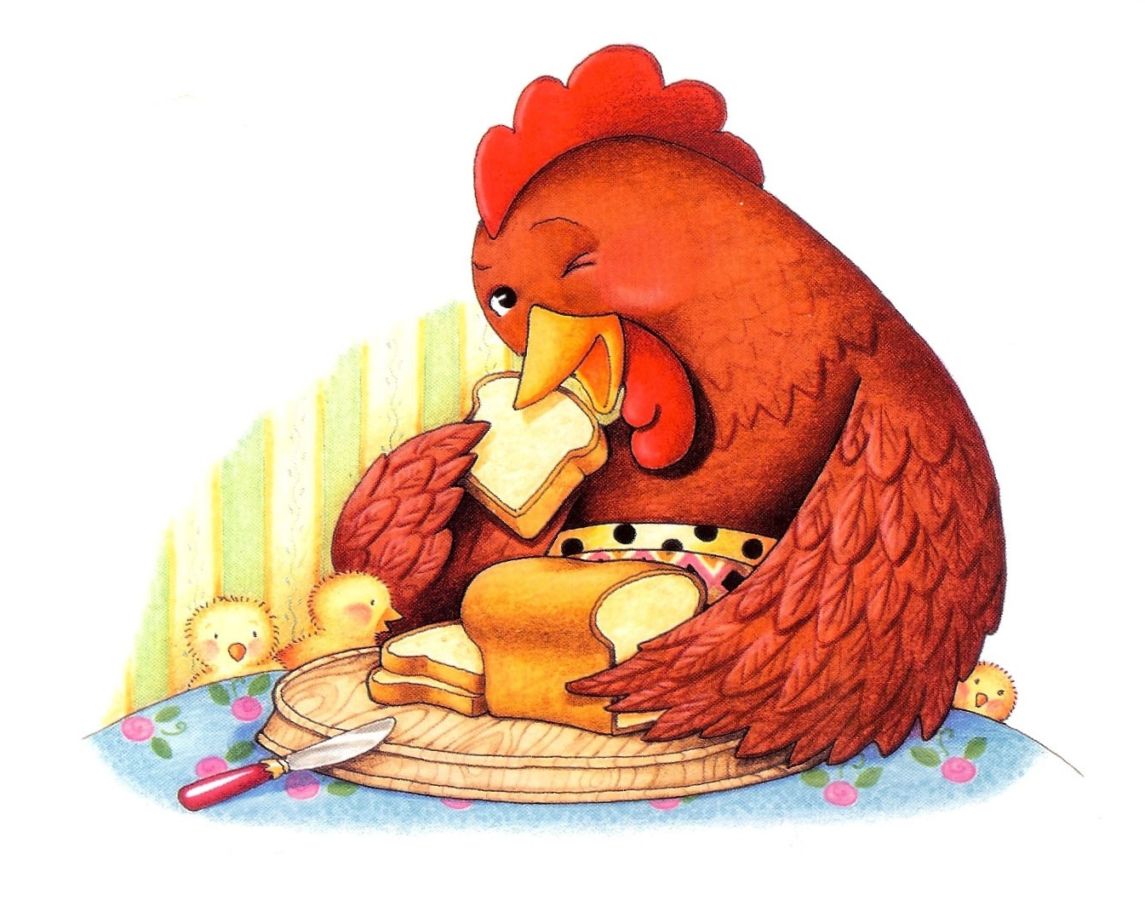
And she eats all the bread.
All…all…all the bread.

Slide 37



The end.

